Slide 1


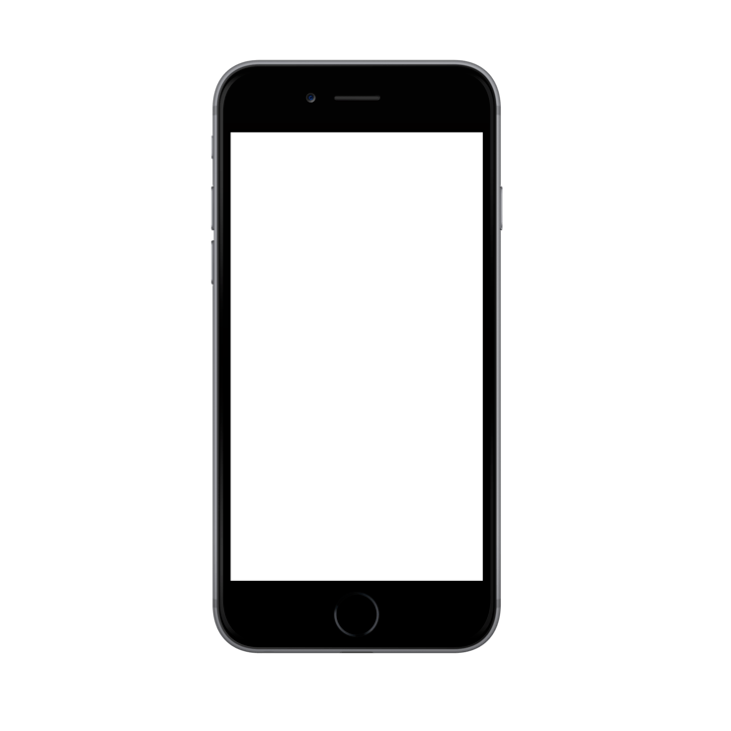
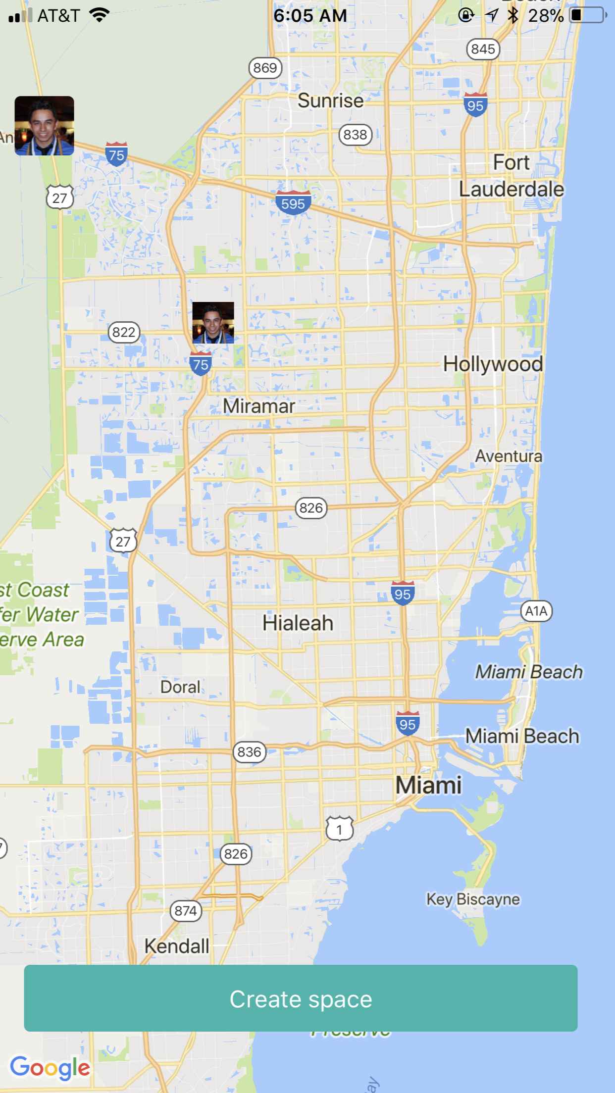
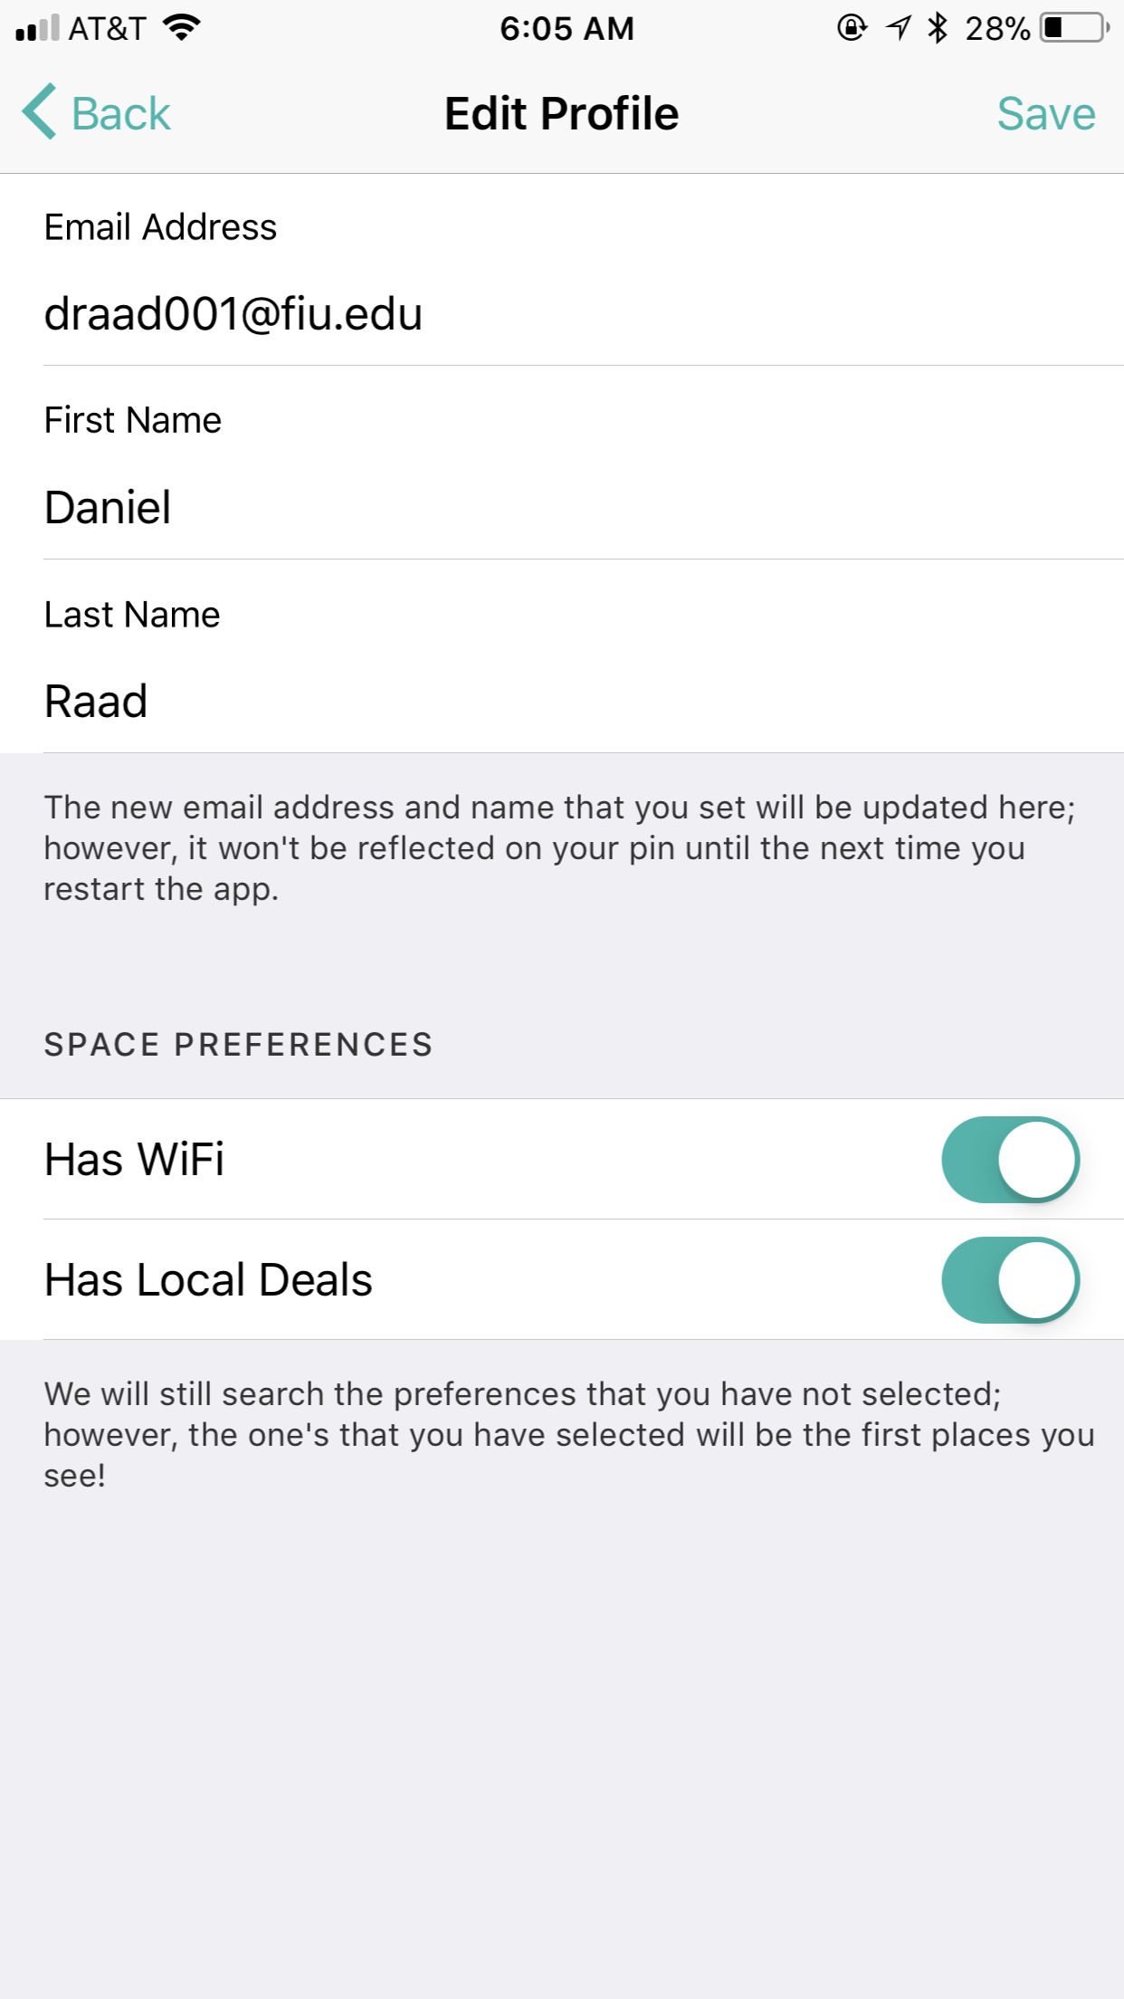
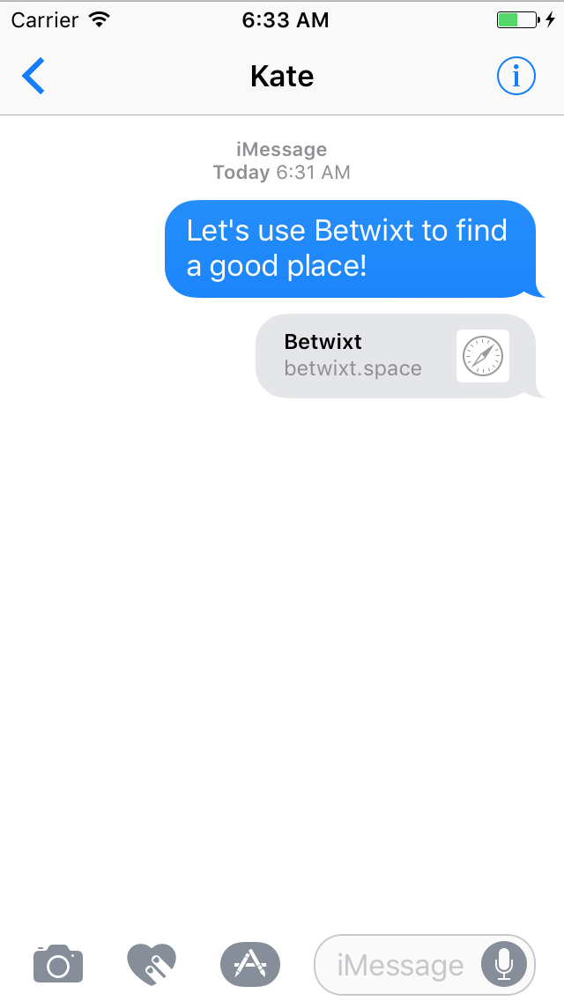
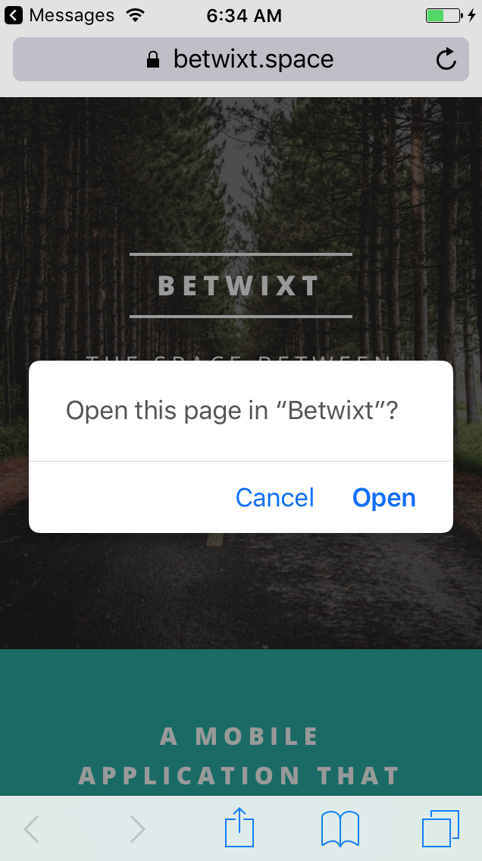
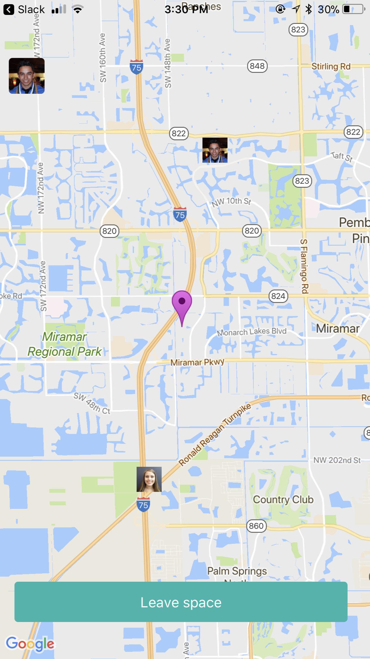


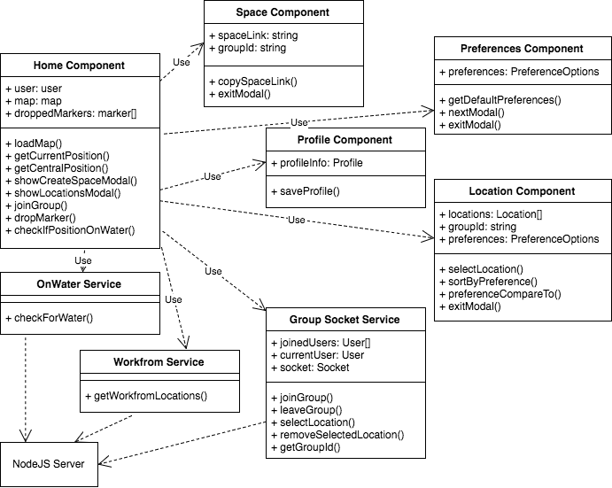
School of Computing & Information Sciences
Senior Project, 2017, Fall
Betwixt 1.0
Student: Daniel Raad, Florida International University
Mentor: Joseph Cutrono, Ultimate Software
Instructor: Masoud Sadjadi, Florida International University
Problem
Virtual employees (VE) want to meet up to work together in person
It’s a hassle to find a location to meet up that satisfies everyone
VEs would like a fast and convenient way to find a public space to meet up that is fair and central to everyone
Solution
An intuitive mobile application that handles the logistics of finding a place to meet
The application takes all of the VEs geolocation and then allows the host to pick a meeting space from the suggested locations
Current System
An iOS and Android application
Host creates a space in the app and invites coworkers with a link
A list of suggested locations is given to the host
The host may choose a location
Modifying your profile
Clicking on your profile picture on the top-left hand side allows you to edit your profile
Send a link to invite coworkers
You may send a link created in the application to another VE and they may join your space
Requirements
Mobile application for both iOS and Android devices
Facilitates the logistics for VEs who wish to meet up to collaborate
A space is created, others invited via link, and a central location is chosen
Ability to set preferences to find locations
Central location is calculated using all of the VEs geolocation
Pins will be visible on the map for the VEs, central location, and chosen location
System Design
and Implementation
Services and APIs
Google Maps
Displays map and pins used in the application
Workfrom.co
API used to query
for locations
PhoneGap Build
Compiles hybrid apps
in the cloud
Onwater.io
Determines whether a location is in water
Verification
Exploratory testing on iOS and Android using emulators and actual devices
Object Design
Summary
A mobile application for virtual employees that facilitates meeting up
It solves the given problem by reducing the manual planning and hassle required to coordinate with a group of people
A host creates a space in the app, sends an invite link to coworkers, and may then select a location which is central to all employees
The pins of all the employees, the central location, and chosen location are displayed on the map
Acknowledgements
The material presented in this poster is based upon the work supported by Joseph Cutrono.
I am thankful for the help that I received from my team members, Alicia Rodriguez and Alejandro Palacios.
Notes:
Problem – Solution – Current System
Images
Requirements – System Design – Implementation
Verification – Object Design – Summary
1

